Slide 1
Automatically Generated aCRF
17NOV, 2016
Chase Liu

Slide 2

Agenda
Why Need Auto
The Mechanism
The Process

Slide 3
WHY NEED AUTO

Slide 4
WHY
▲ Why Need Auto
Old Way: Copy from reference study or from Janssen DCM
-Tedious & Repetitive & Time Consuming
-Lead to inconsistence
New Way: Automatically generated by SAS program
-Fast
-Standard

Slide 5
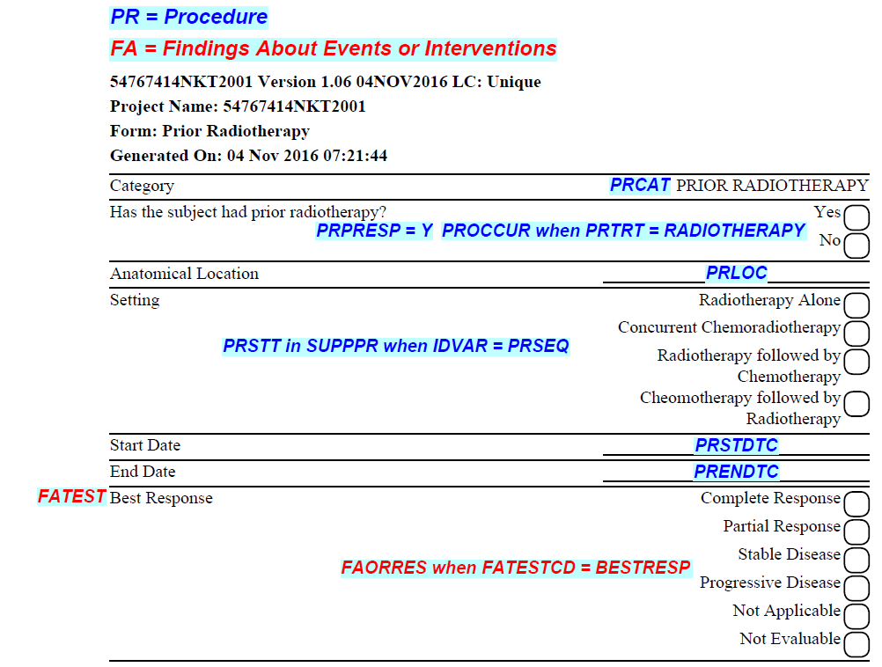
Auto acrf

Slide 6
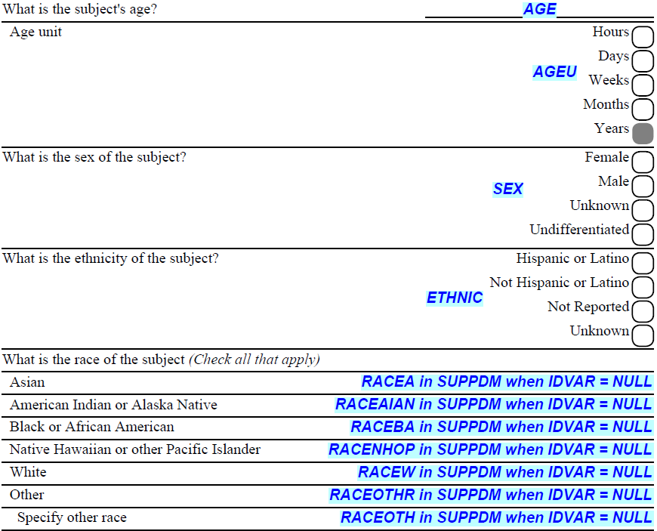
Auto acrf

Slide 7
The mechanism

Slide 8
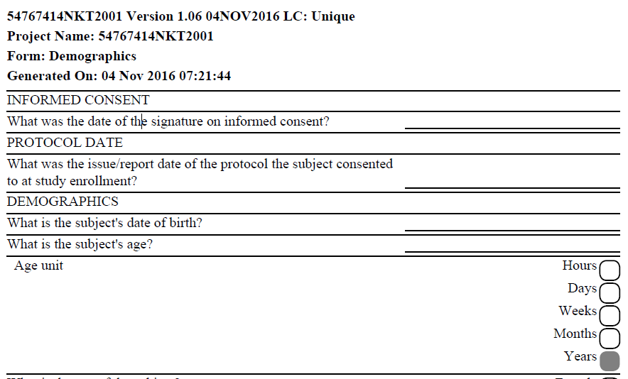
FEASIBILITY
▲ Standard Structure of CRF in Medidata RAVE

Slide 9
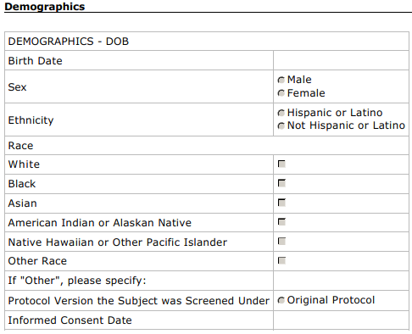
FEASIBILITY
▲ Non-Standard Structure of CRF

Slide 10
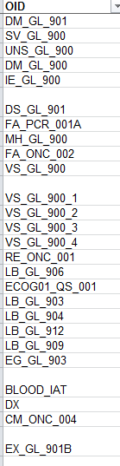
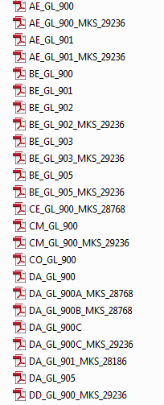
FEASIBILITY
▲ Janssen DCM(Data Collection Modules)
From Sharepoint
From ALS

Slide 11
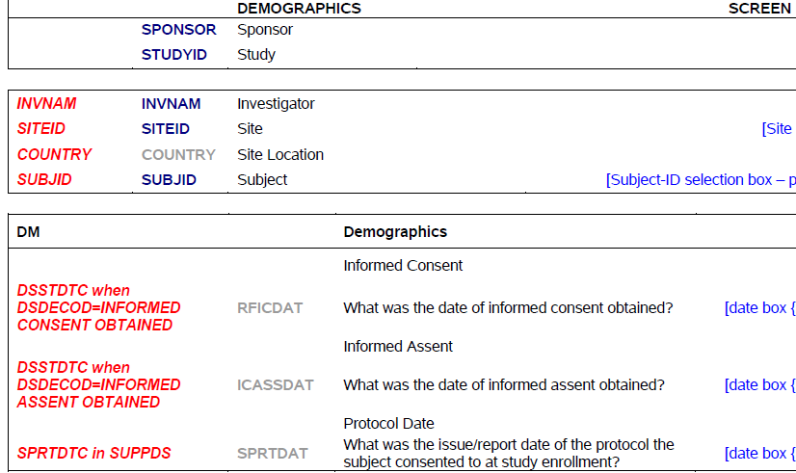
FEASIBILITY
▲ Janssen DCM(Data Collection Modules)

Slide 12
MECHANISM
Get Annotation for Every Field
aCRF
Put Annotation in Correct Position in CRF
Define Library
Extract from CRF
Through Java Script

Slide 13
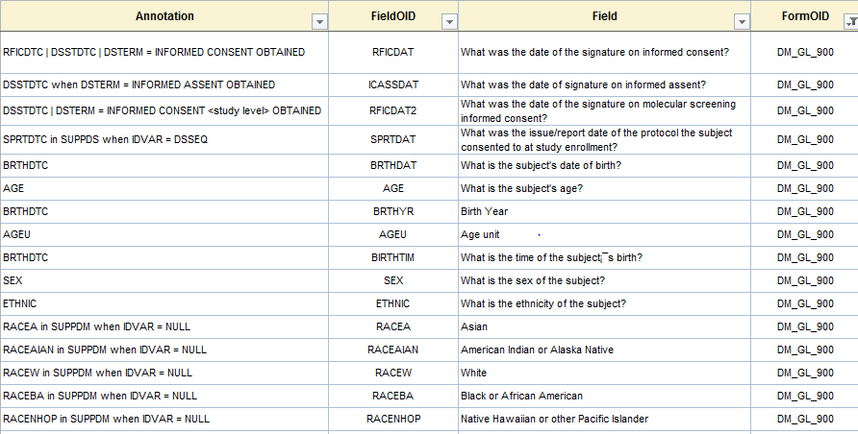
Define library

Slide 14
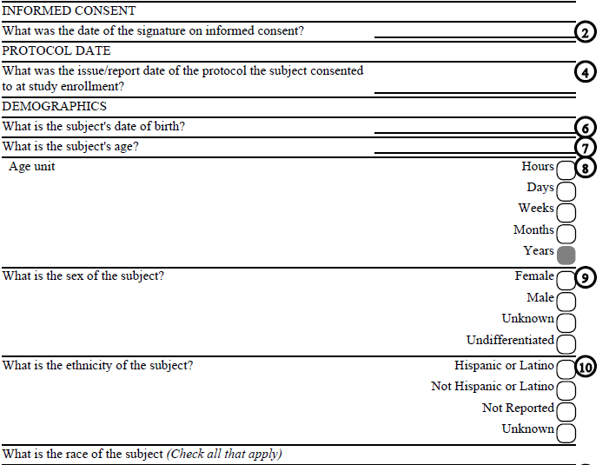
FIELD POSITION

Slide 15
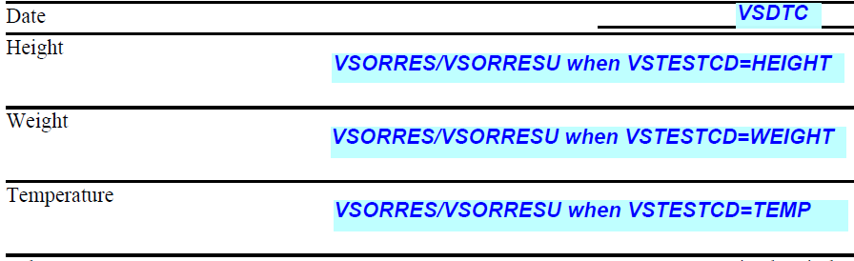
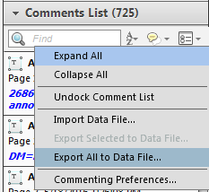
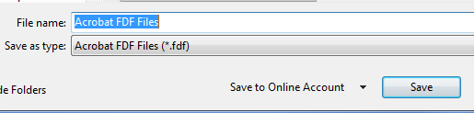
Annotation CRF
Annotations is stand along from PDF
We can extract it by Adobe Reader

Slide 16
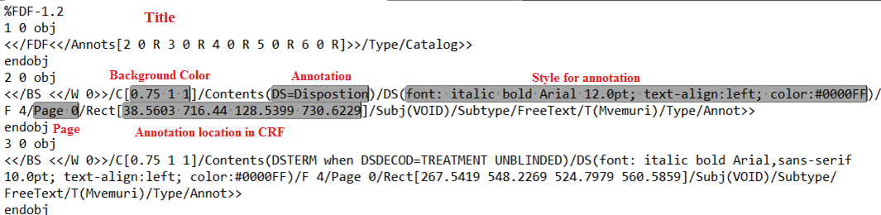
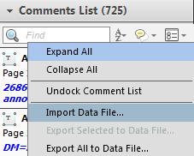

Forms DATA FORMAT(FDF)
Open FDF by any text editors
Extract through Perl regular expression
Import Back

Slide 17
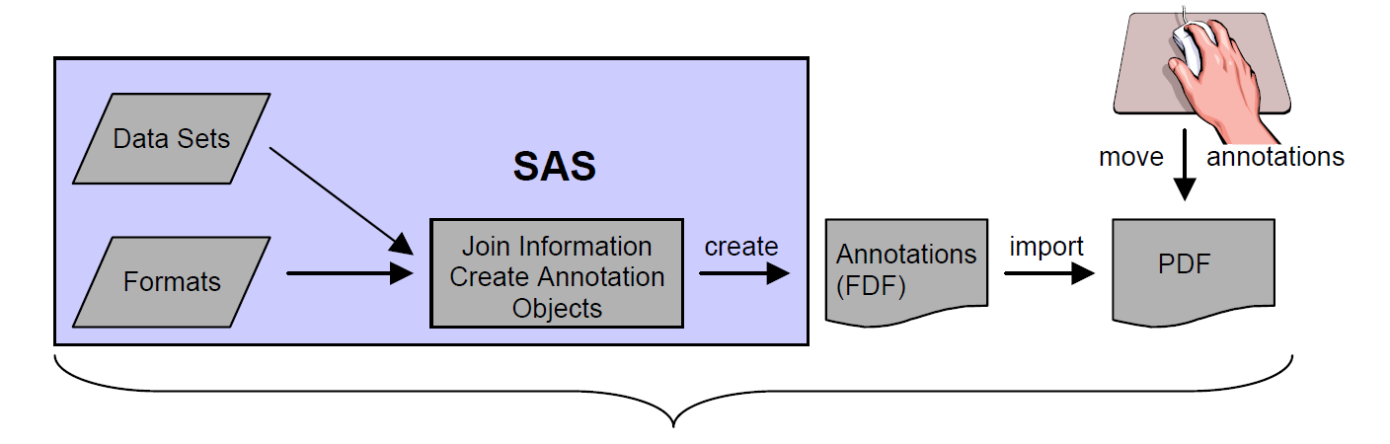
MECHANISM
ALS
Define

Slide 18
The process

Slide 19
PROCESS
Get input files from DB Programmer
ALS
Unique CRF
Run custom action in Adobe Acrobat
fdf_adjust.fdf
fdf_final.fdf
Dictionary CRF
BlankCRF_Bookmark.txt
DictionaryCRF_Bookmark.txt
DictionaryCRF_Links.txt
Put all files in correct folder and run AutoGenaCRF.sas

Slide 20
aCRF
With ALS Contents Added

Slide 21





ALS Contents added aCRF
Key Features
FormOID
FieldOID and Attribute
LogLine Highlight
Codelist Added
AnalyteName Added

Slide 22
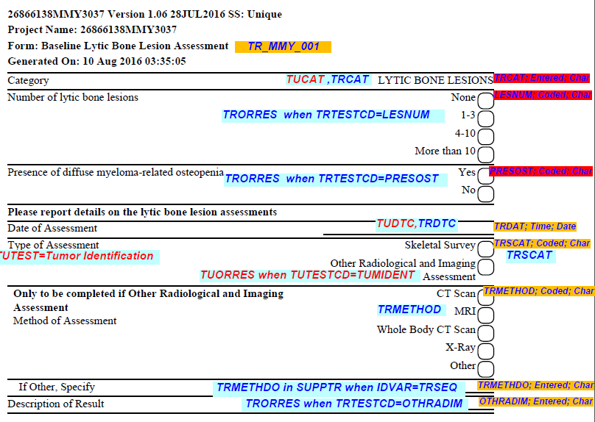
ALS Contents added aCRF

Slide 23
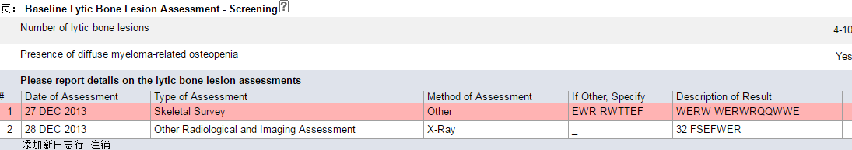
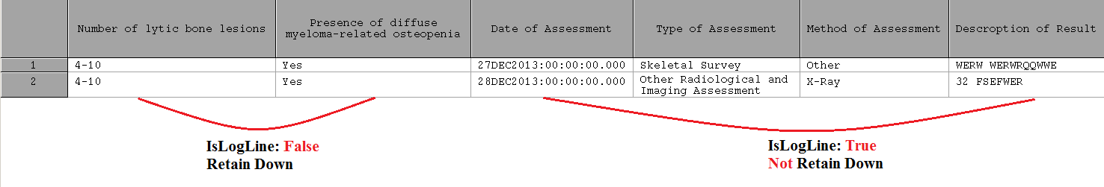
Why need highlight logline
In RAVE
In SAS Dataset

Slide 24
Update Annotation
After migration

Slide 25
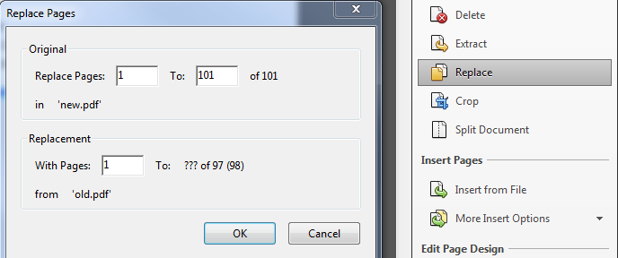
Two simple approach to UPDATE annotations
Method1: Replace PDF
Method2: Export annotation and import back

Slide 26
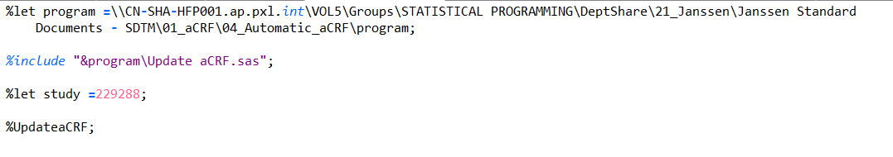
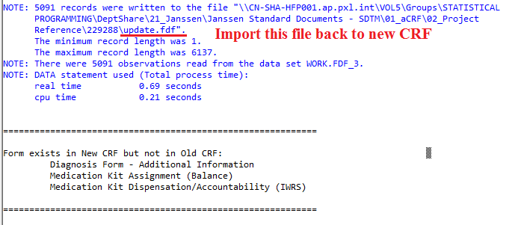
A SAS Macro to update annotation

